Slide 1







EMERGING TECHNOLOGY TRENDS
Monica Nahabwe
30th November 2022

Slide 2



OUTLINE
Executive Summary
Introduction
Methodology
Results
Visualization – Charts
Dashboard
Discussion
Findings & Implications
Conclusion
Appendix

Slide 3

EXECUTIVE SUMMARY
Developers are majorly men, below forty years of age and have mostly bachelors
Currently the top programing include are JavaSript, HTMl/CSS , SQL & Python while the most desired databases are Postgress SQL, MongoDB, Redis, MySQL & Elasticsearch
In future, the most desired languages will be JavaScript, HML/CSS , Python, SQL & TypeScript while databases will be Postgress SQL, MongoDB, Redis, MySQL & Elasticsearch

Slide 4

INTRODUCTION
This project thought to identify trends on emerging skills in Technology
Specifically, the project findings highlight the following;
the top programming languages and databases in demand and future demand
popular IDEs
Demographic characteristics of the developers including their age, education level and gender
Audience
Developers and IT Industry leaders
Policy makers

Slide 5

METHODOLOGY
Data collection: Data on demanded Technology skills was collected using APIs and Webscraping from job postings, surveys e.t.c
Data wrangling and preparation: This was done by removing duplicates and imputing missing values and normalized the data
Data Analysis: Statistical techniques and analysis were employed to unearth insights and trends in the data
Findings and Discussions
Visual plots such as bar graphs and pie charts were used
Dashboards of Databases and programing language trends
Conclusion were drawn from the trends

Slide 6
RESULTS
Demographics of Developers:
Majority of the Developers(93.5%) are men
the mean age is 31, and majority are under the age of forty
Majority have a bachelors degree
Programing languages:
The most used languages are JavaSript, HTMl/CSS , SQL , Bash/Shell/ PowerShell & Python
The most desired languages next year are JavaScript, HML/CSS , Python, SQL & TypeScript
Databases
The most used data bases are are MySQL, Microsoft SQL Server, Postgress SQL, SQLite & MongoDB
The most desired databases are Postgress SQL, MongoDB, Redis, MySQL & Elasticsearch
Conclusion
The future technology skills demand will not change significantly, most of the currently demanded skills will still be demanded in future

Slide 7
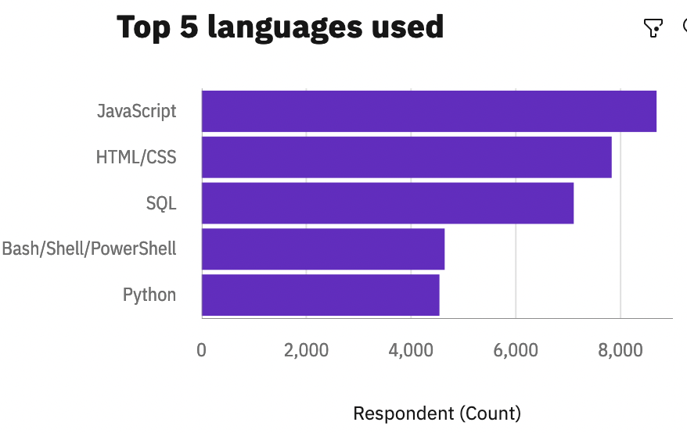
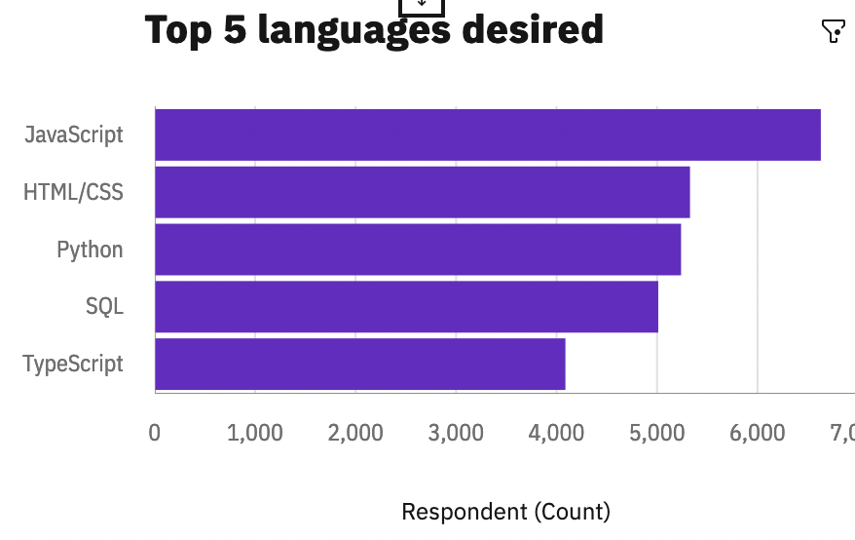
PROGRAMMING LANGUAGE TRENDS
Current Year
Next Year

Slide 8
PROGRAMMING LANGUAGE TRENDS - FINDINGS & IMPLICATIONS
Findings
JavaSript, HTMl/CSS are the leading demanded applied languages and will be the most in demand in future
Python is increasingly getting demanded. From 5th position to to the third position next year
The JavaSript, HTMl/CSS & python are among top 5 in demand this year and will be next year
Implications
Web design and development is a highly demanded skill and will still be demanded in future
Since python is easy to learn even by beginners, and the broad community, it is most likely going to be the language of the future developers
These three languages are a must have on the resume for aspiring developers

Slide 9
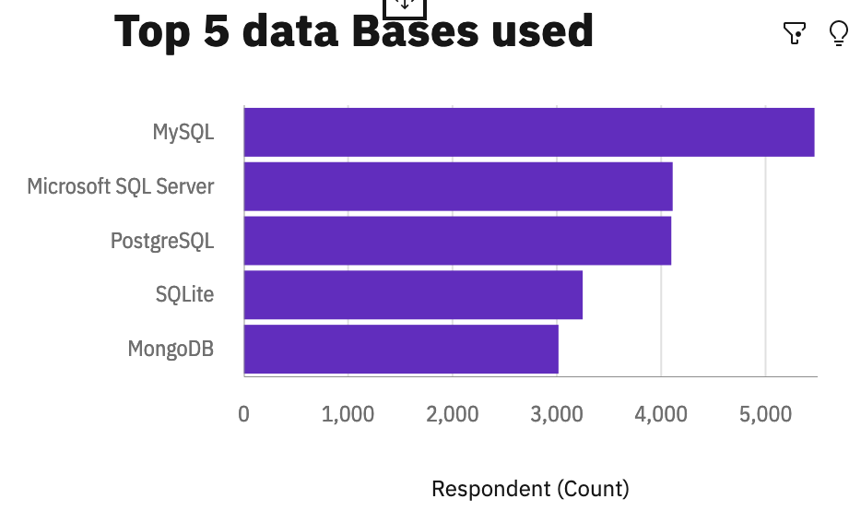
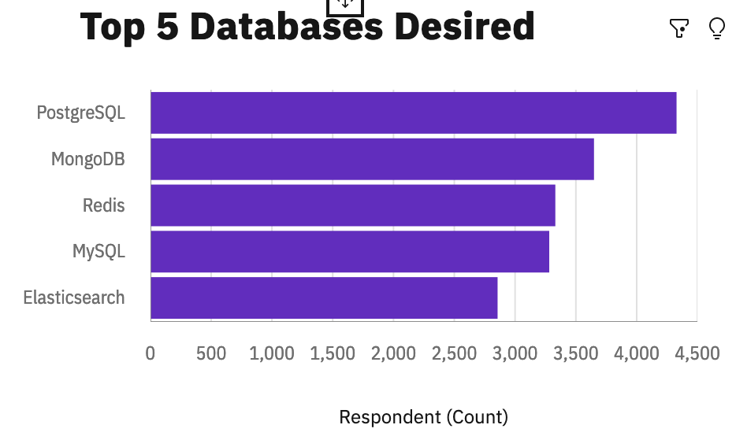
DATABASE TRENDS
Current Year
Next Year

Slide 10
DATABASE TRENDS - FINDINGS & IMPLICATIONS
Implications
Open source databases like MySQL are still in high demand
Data bases that supports modern application features like JSON, XML unlike MySQL which only supports JSON are increasingly getting demanded
MongoDB’s ability to store both structured and unstructured databases is making it very popular among the Developers
Findings
MySQL is currently the most in demand data base skill
MySQL will be overtaken by Postgress SQL as the most in-demand database skill in future
MongoDB is increasingly getting demanded from 5th position to second condition next year.

Slide 11

DASHBOARD
https://eu2.ca.analytics.ibm.com/bi/?perspective=dashboard&pathRef=.my_folders%2FCapstone&action=view&mode=dashboard&subView=model00000184bd885e72_00000000

Slide 12
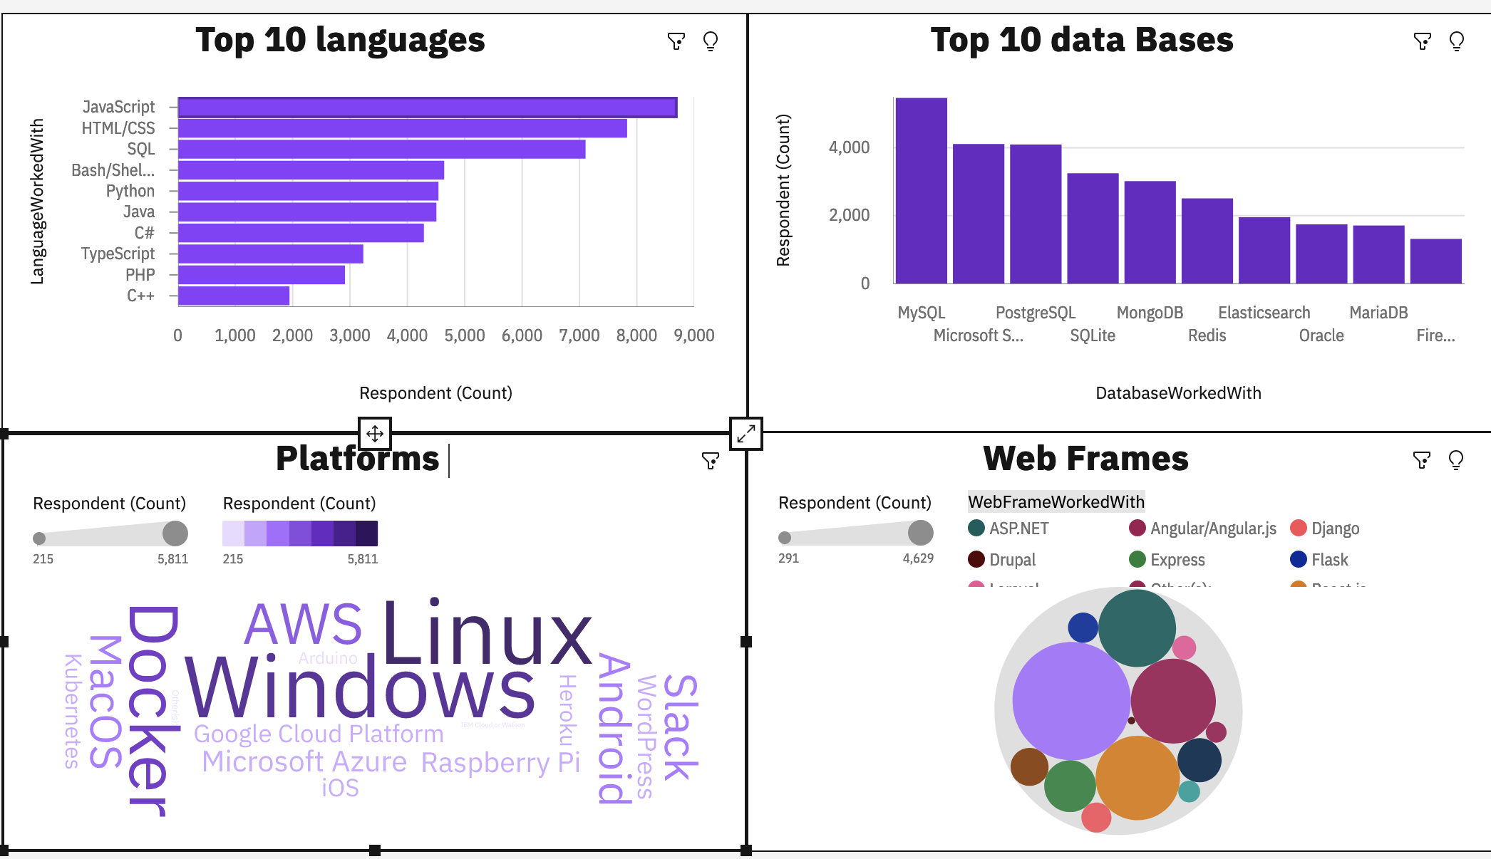
Current Technology Usage

Slide 13
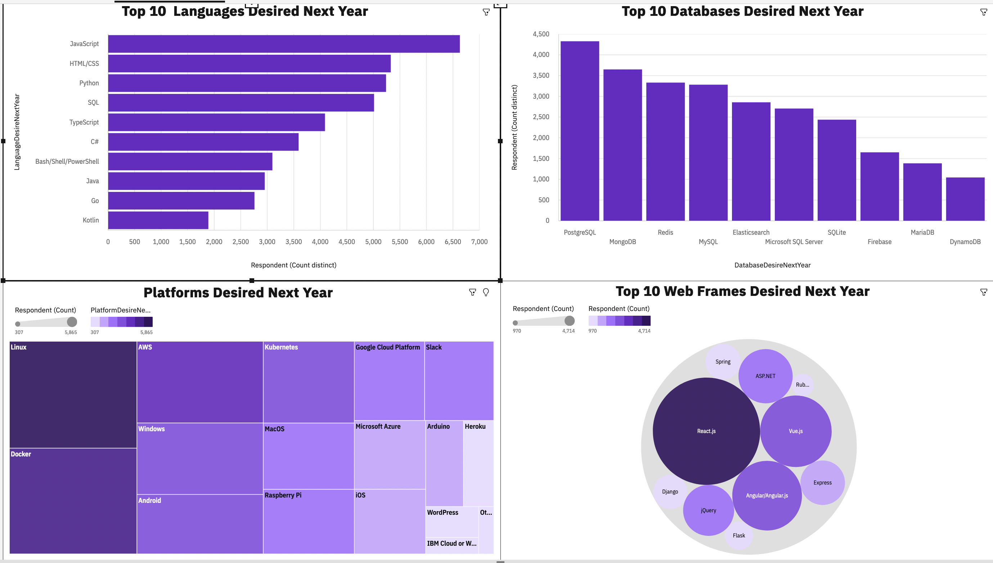
Future Technology Usage
Screenshot of dashboard tab 3 goes here

Slide 14
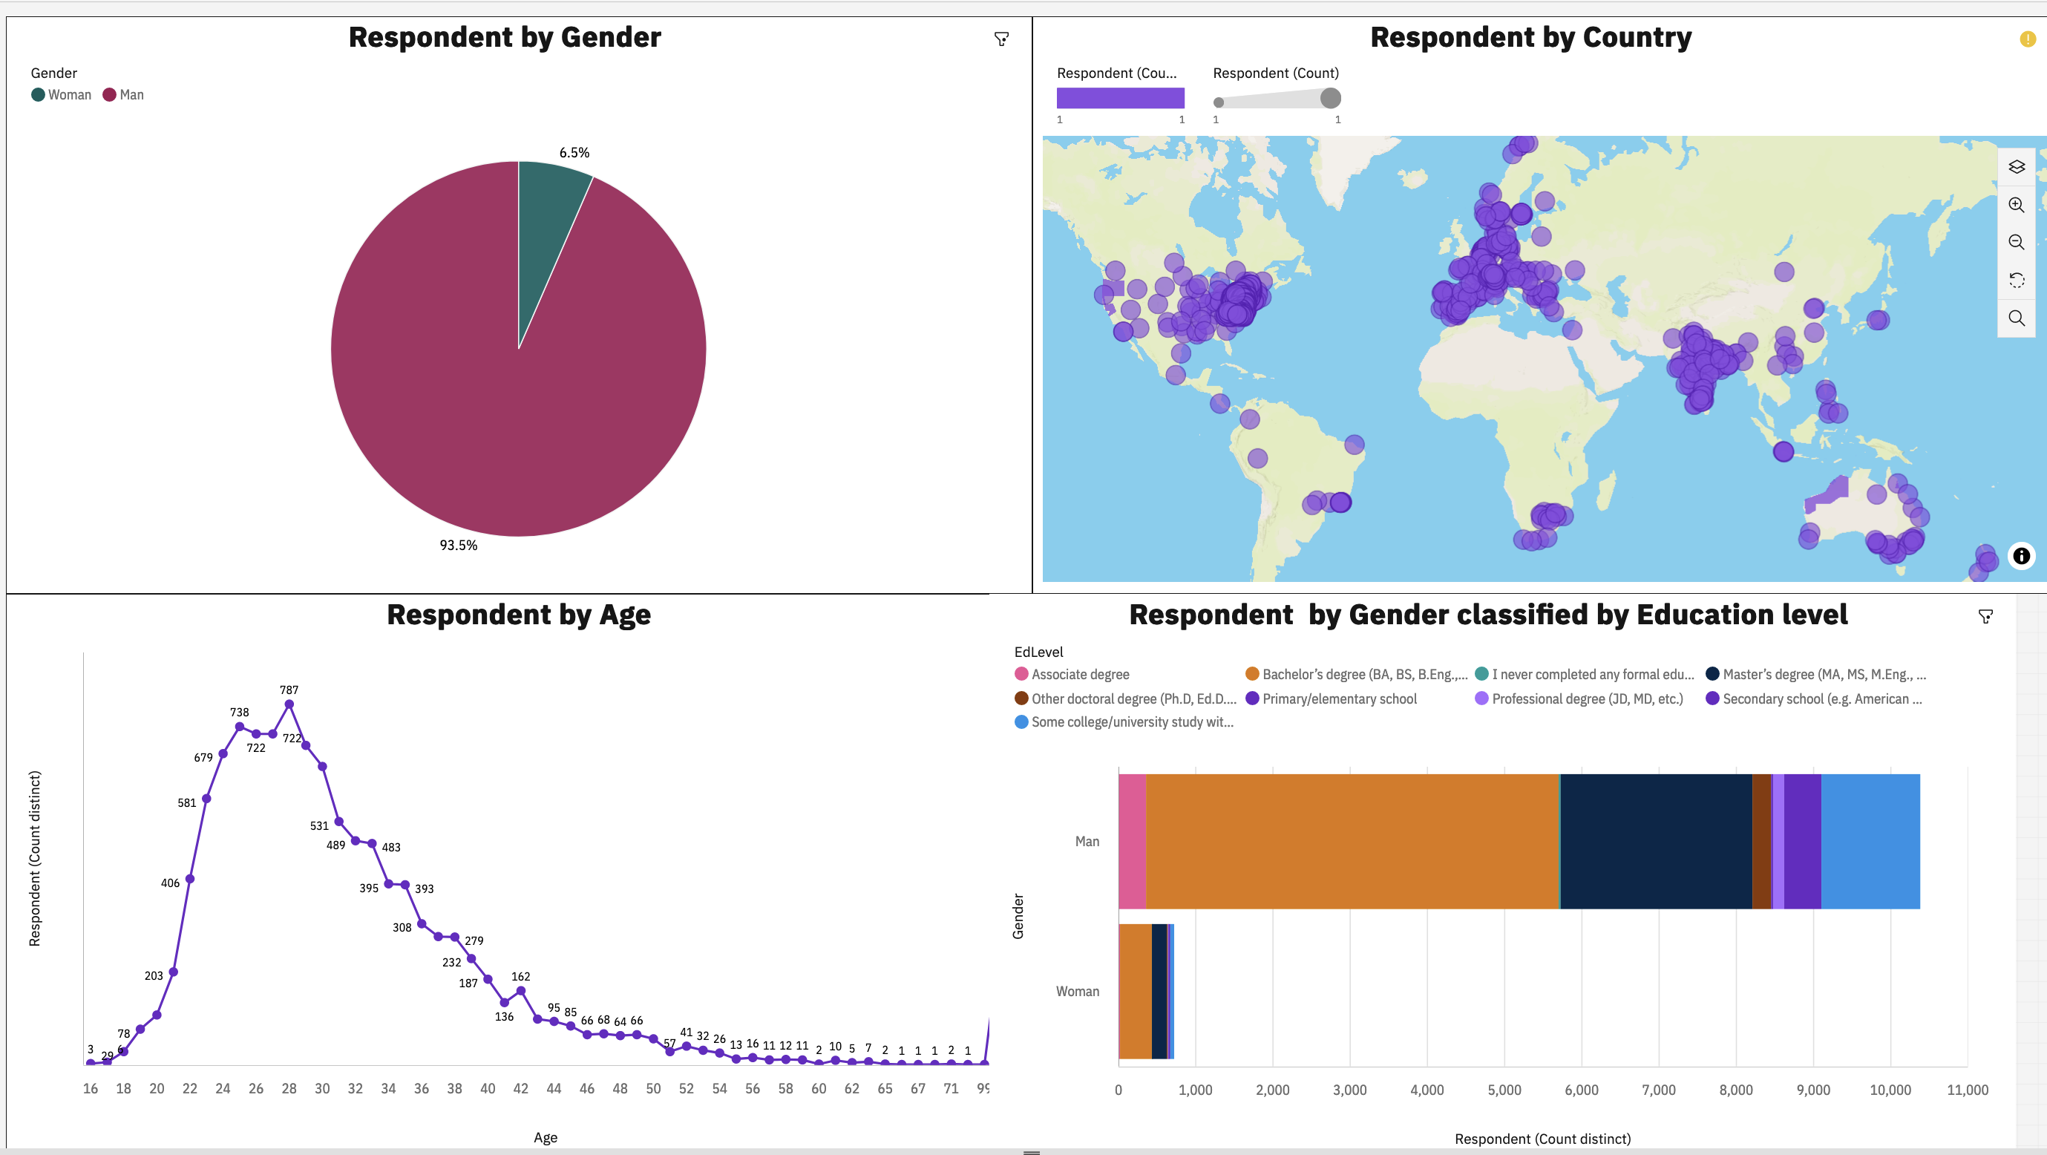
Demographics

Slide 15
DISCUSSION
The future programing languages will be informed by the current in-demand skills so technology companies should focus on building experts in the current on demand technologies
The future demanded database skills will vary from the current trends . This implies that in addition to building expertise in currently demanded database skills, more focus should be put on Postgress and MongoDB
Humanity agencies and NGOs should focus on affirmative action to bring more ladies in the tech industry

Slide 16
OVERALL FINDINGS & IMPLICATIONS
Findings
The developers mostly have bachelors degrees
There is a very big gender gaps in tech industry
technology skills on demand keep changing
Implications
One does not a masters degree to become a developer
Technology is a male dominated field thus efforts to bring more women on board should be put in place
Developers should keep informed of the latest technology trends

Slide 17

CONCLUSION
For developers and IT firms to keep on top of their game, keep interests in trends on
Current $ future programing languages including The JavaSript, HTMl/CSS & python
Current & future database skills including MySQL, PostgressSQL e.t.c
Current & future IDEs including Linux, Docker, AWS & Windows
Policy makers and Socio-Economic aimed Entities should devise means of bringing more women on board in the IT Industry
There is still a gap in Africa for developers

Slide 18

APPENDIX
Job postings per location
Popular languages
Age distribution of developers

Slide 19
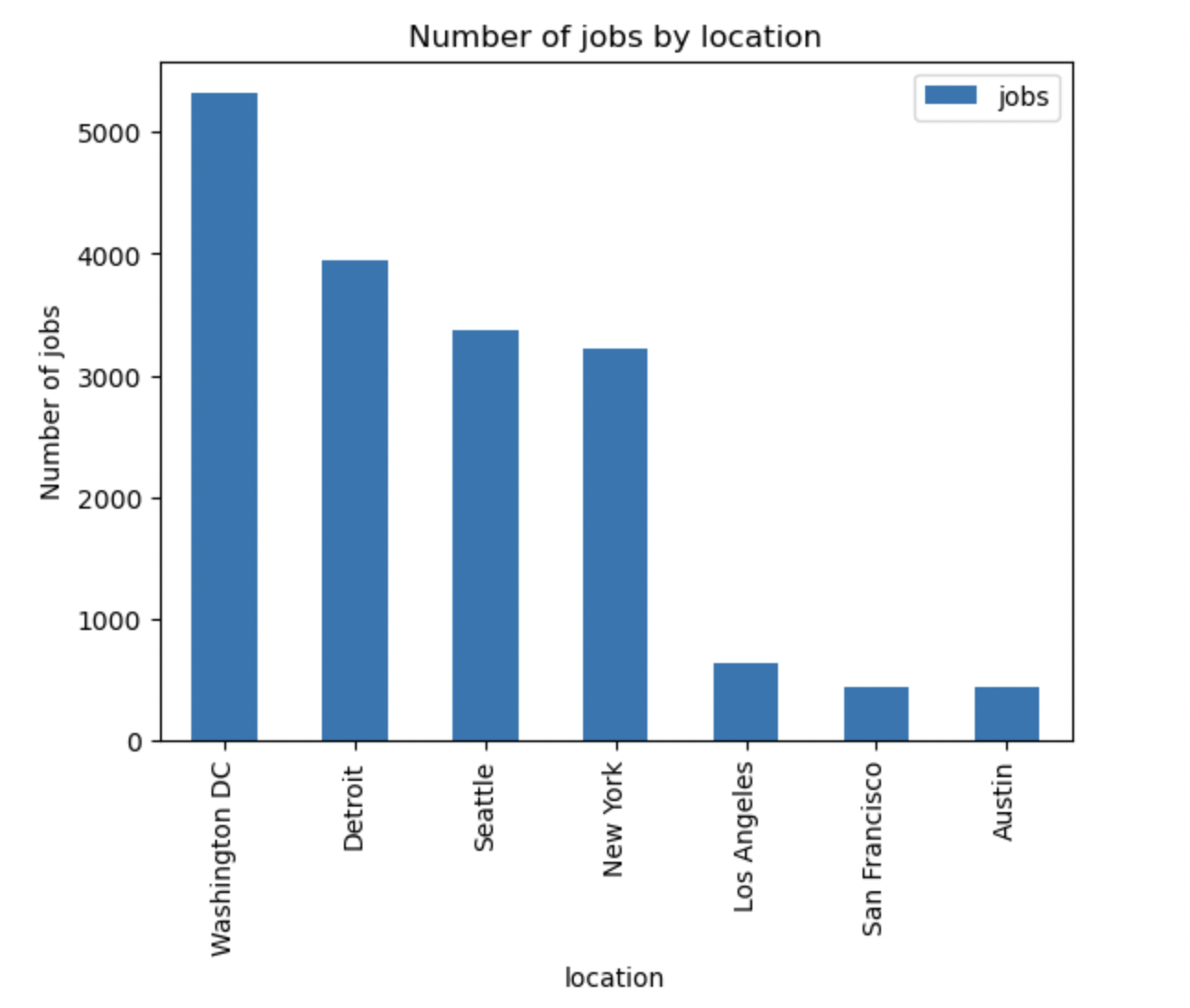
JOB POSTINGS

Slide 20
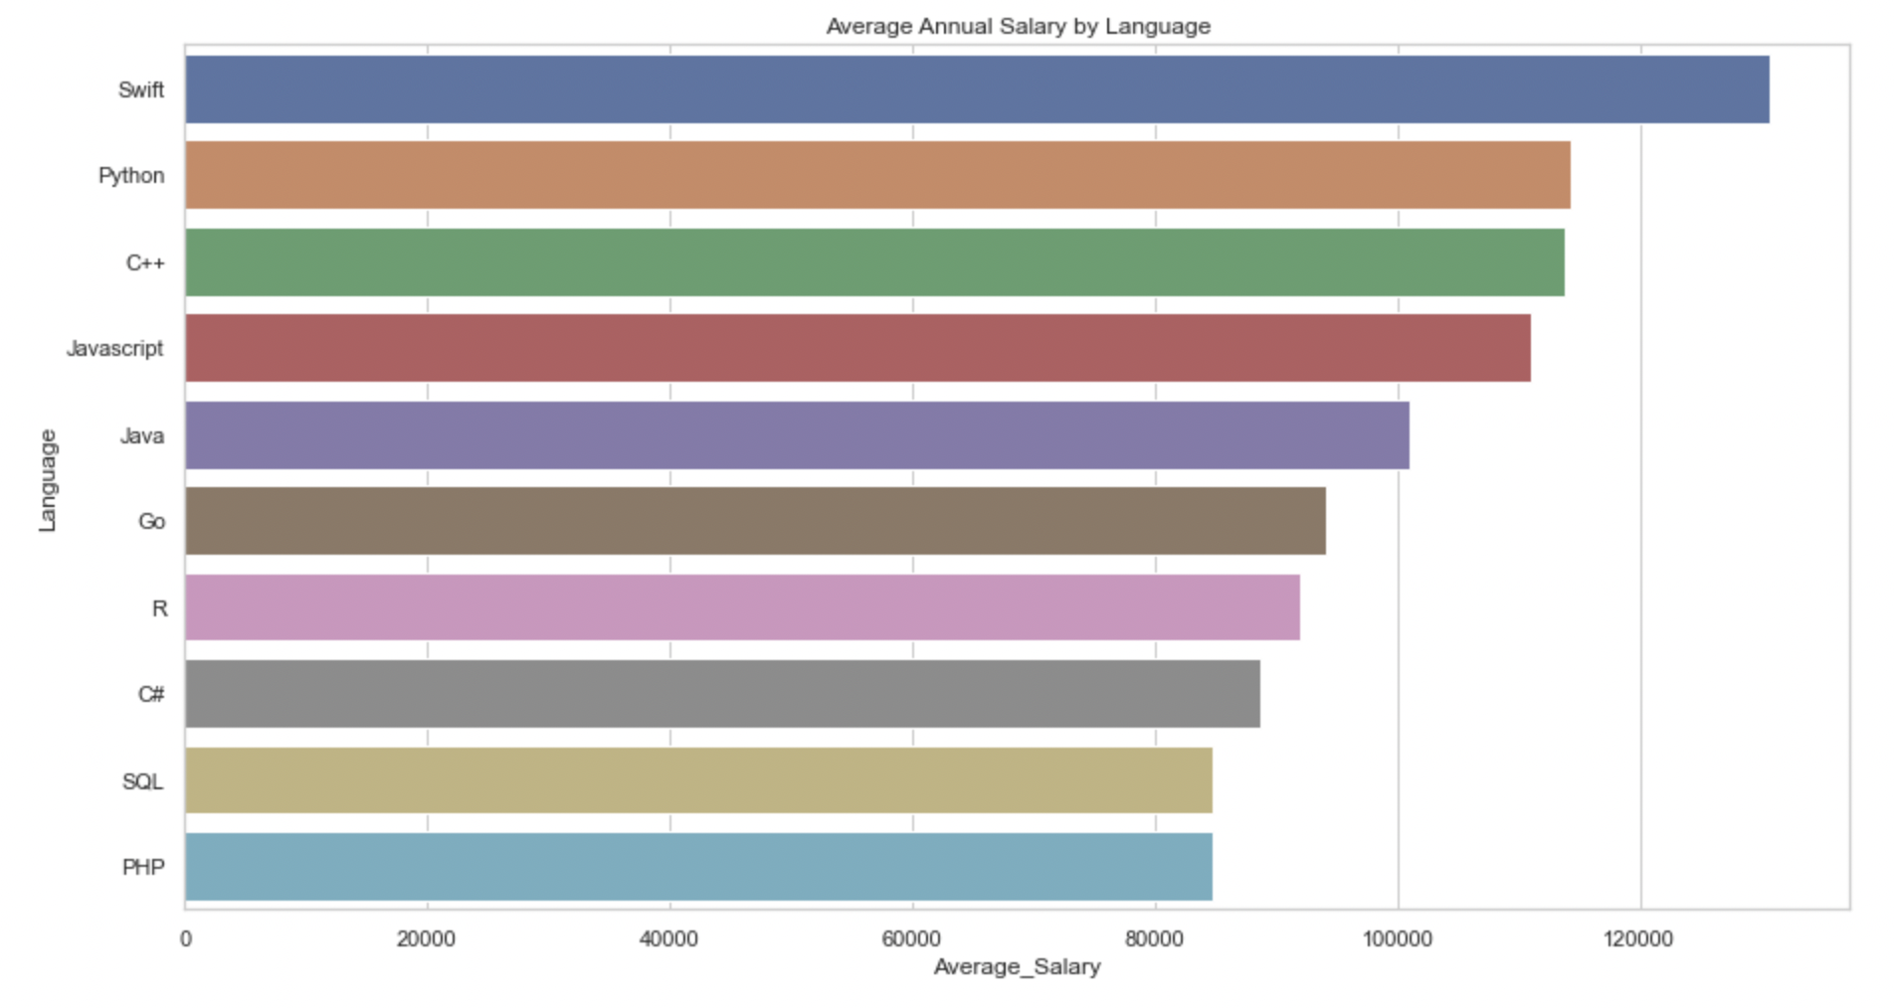
POPULAR LANGUAGES

Slide 21
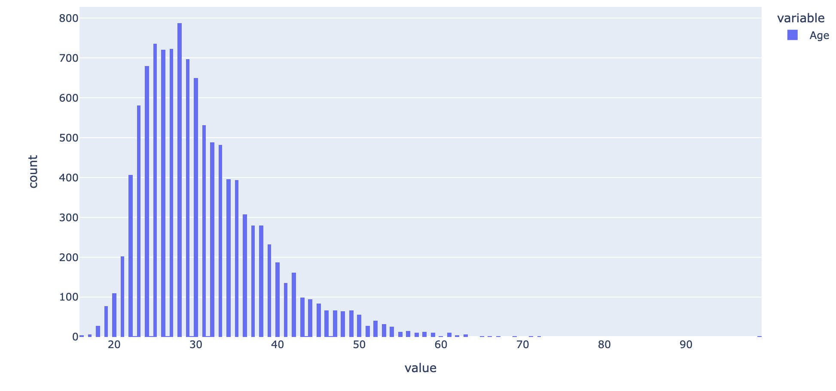
Appendix
Distribution of Age

